Slide 1

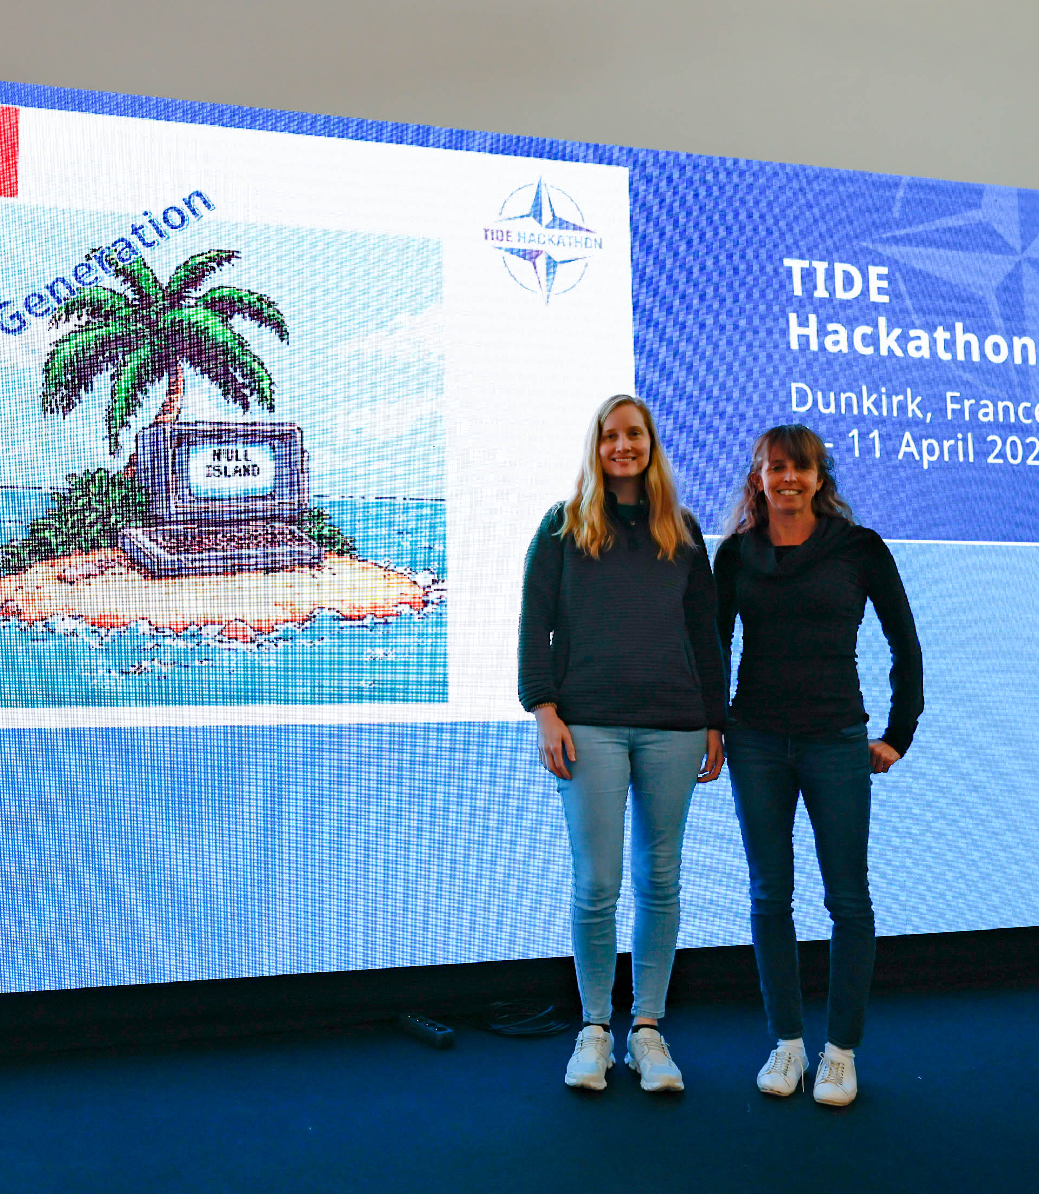
TIDE Hackathon 2025
AI-Driven Video Generation Challenge
NULL ISLAND

Slide 2
Day 1 Decisions
We are just two python data engineers that usually code in Jupyter notebooks
Google Colab was the fastest choice for us to develop and the GPU resources
Did not want any API calls for generation
Streamlit for our GUI
Wanted a one-stop-shop app for all features of AI video to generate a wargame

Slide 3
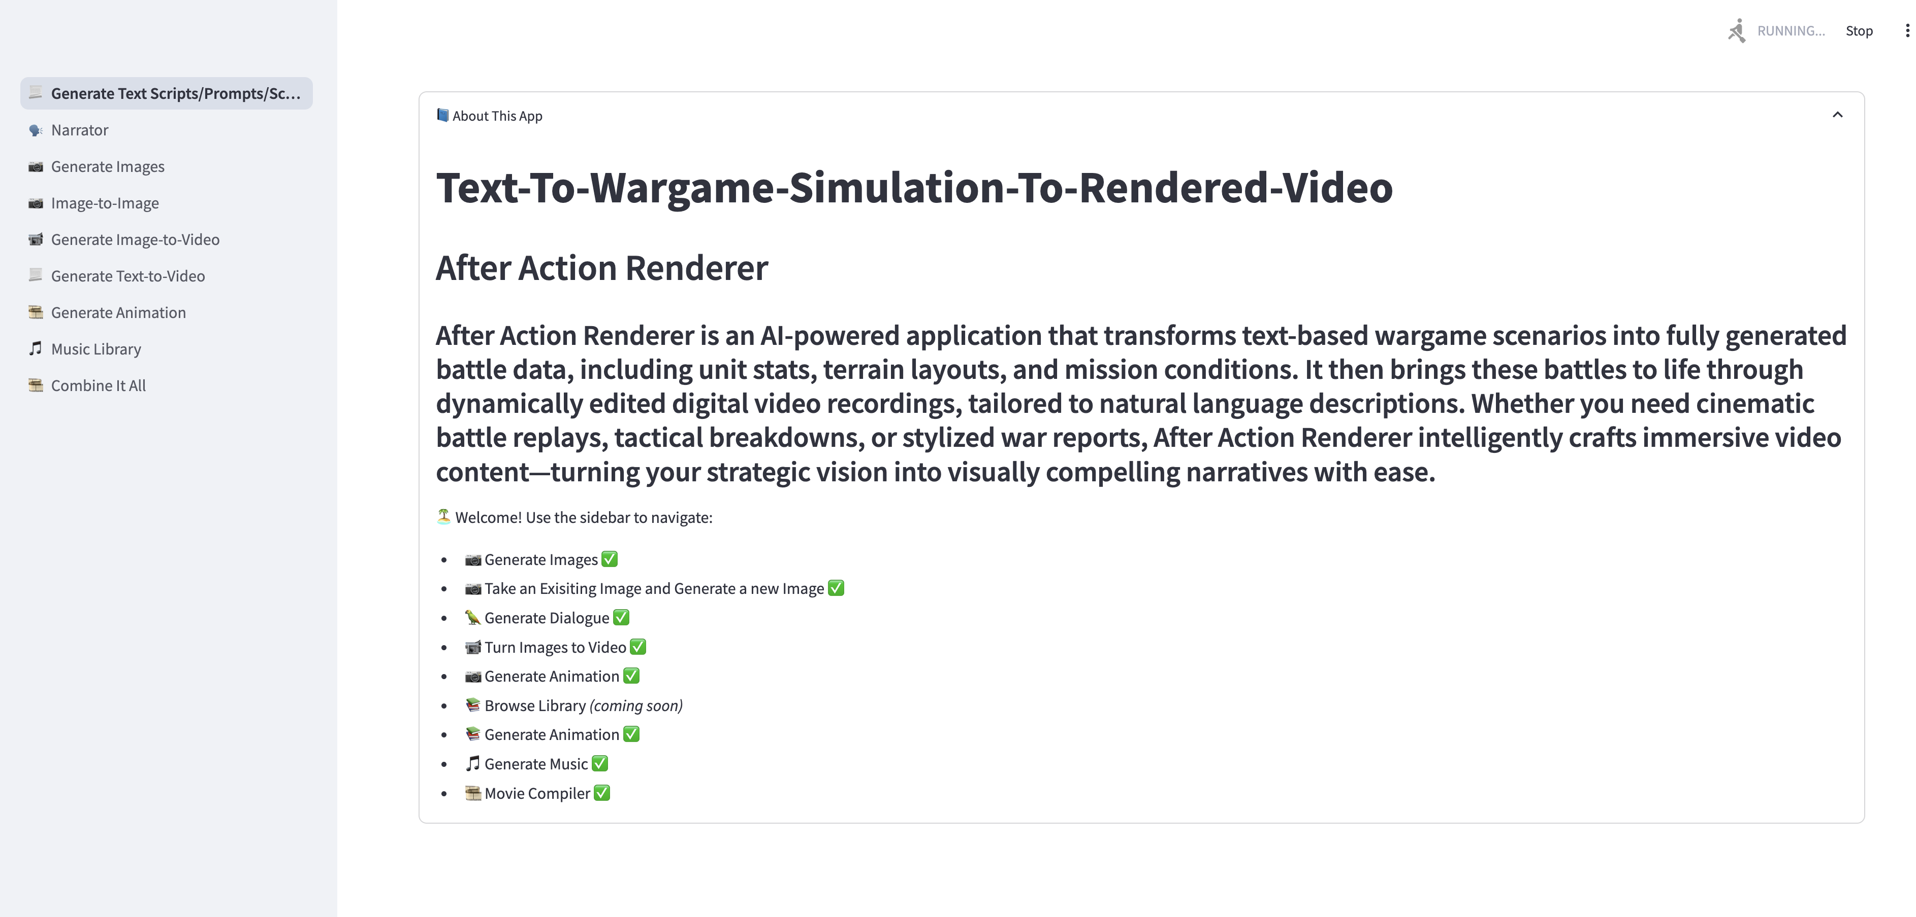
After Action Render App

Slide 4
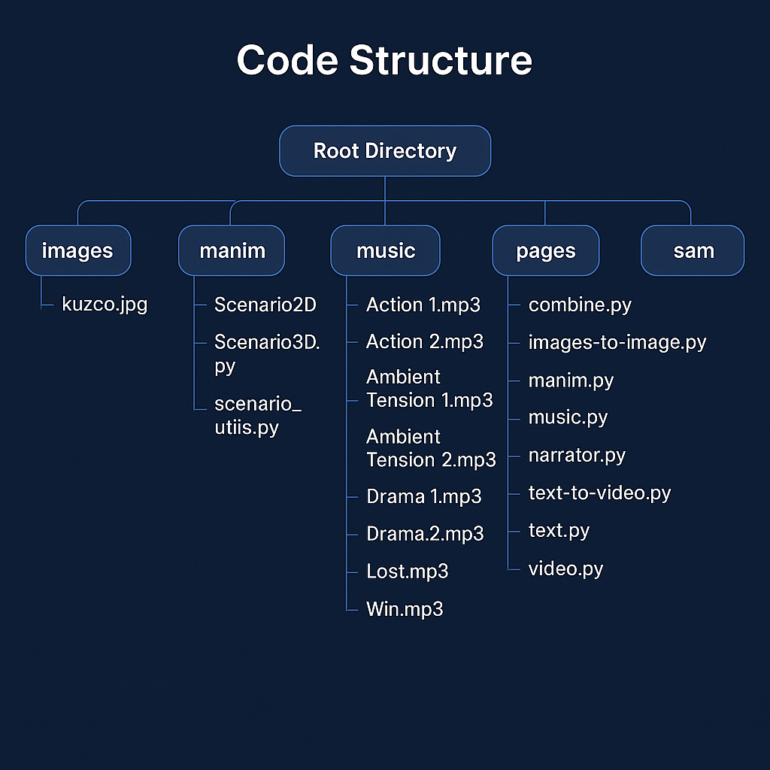
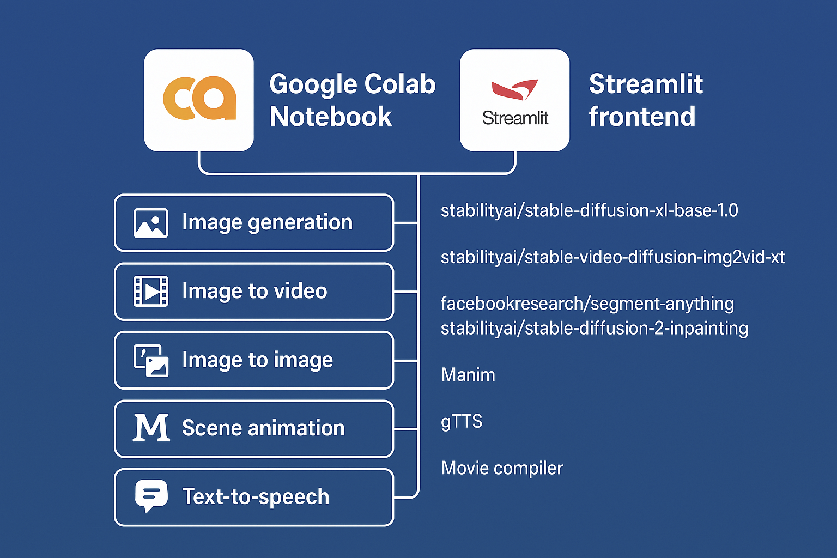
App.ipynb

Slide 5

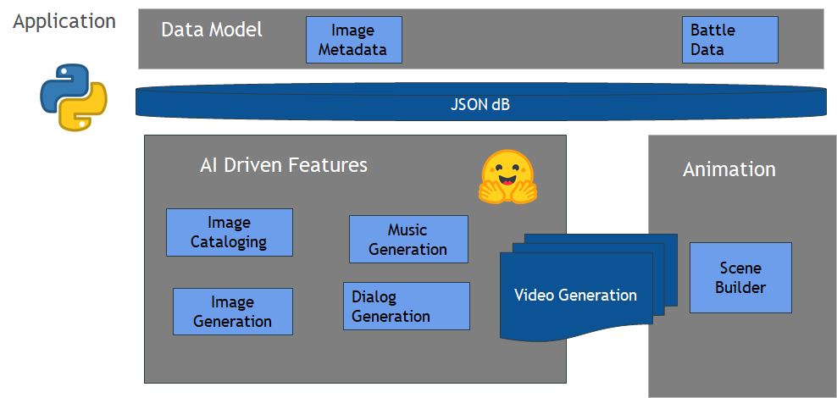
After Action Render

Slide 6
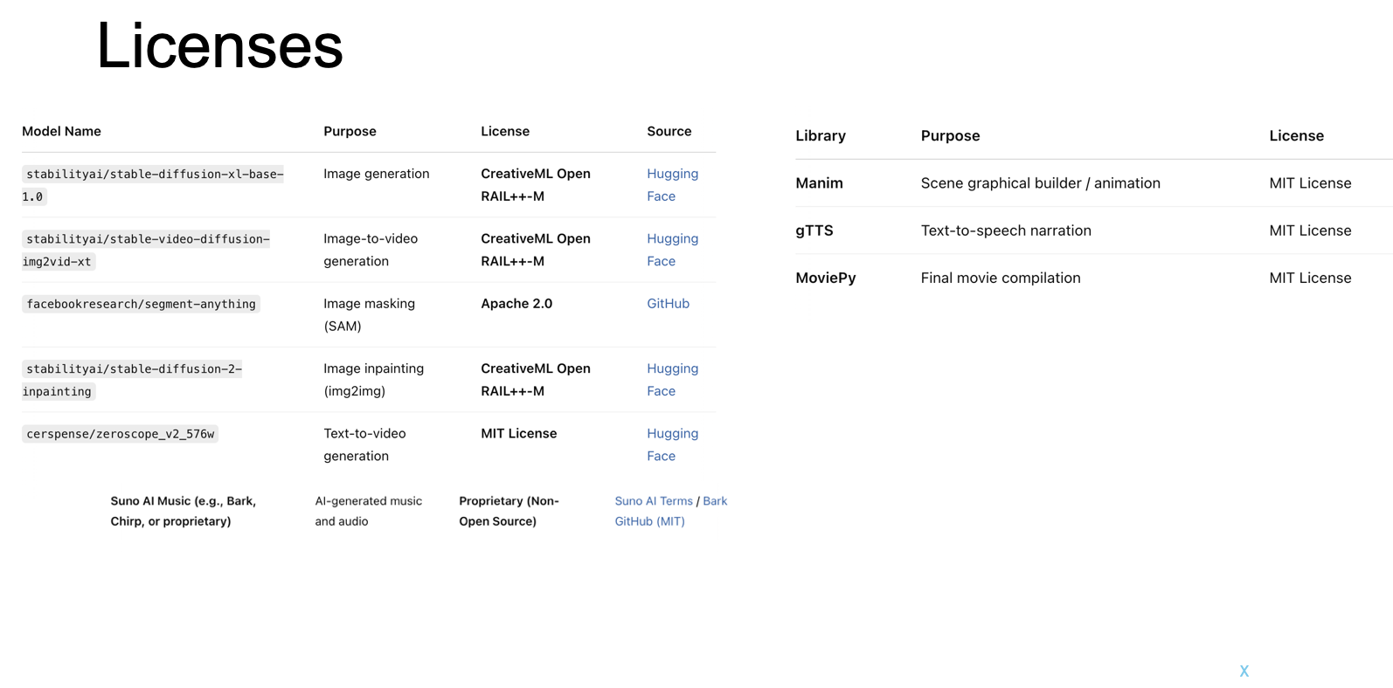
Spacy NLP parts of speech MIT Licence

Slide 7
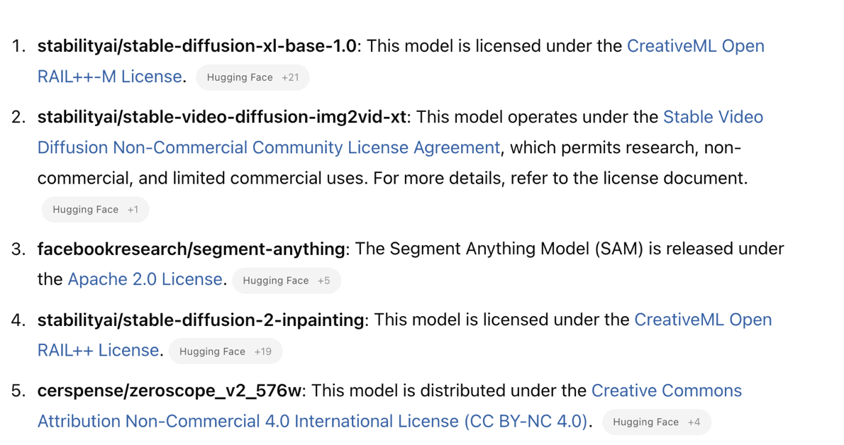

Slide 8
System Requirements
Hardware
GPU: NVIDIA Tesla T4 (Colab environment)
RAM: 12 GB or more (Colab environment)
Disk Space: Sufficient space for storing generated images and model data (Colab provides temporary disk space)
Software:
Operating System: Linux-based (Colab environment)
Python: 3.10.12 (Replace with your current Python version: !python --version in Colab)

Slide 9
The App Features

Slide 10

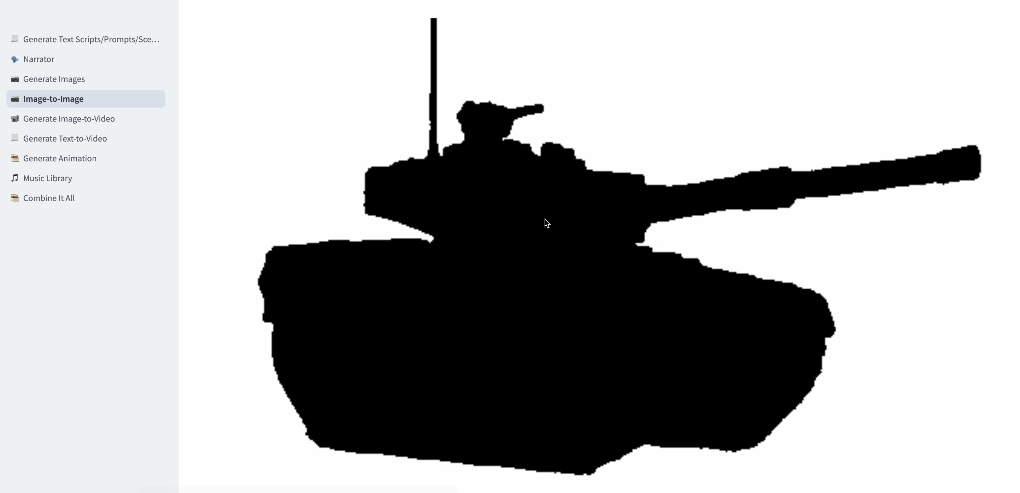
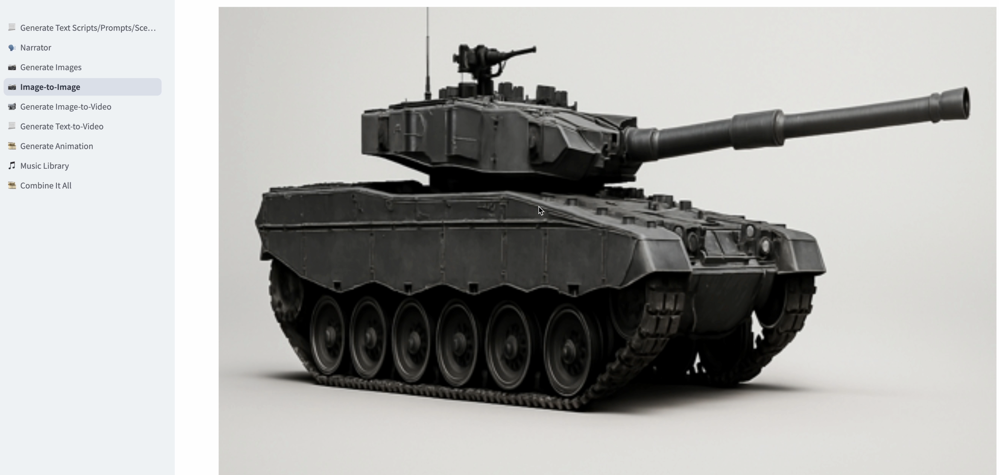
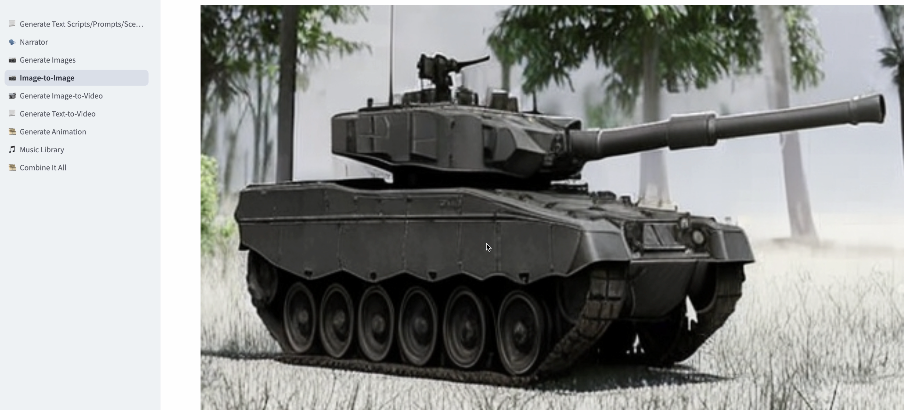
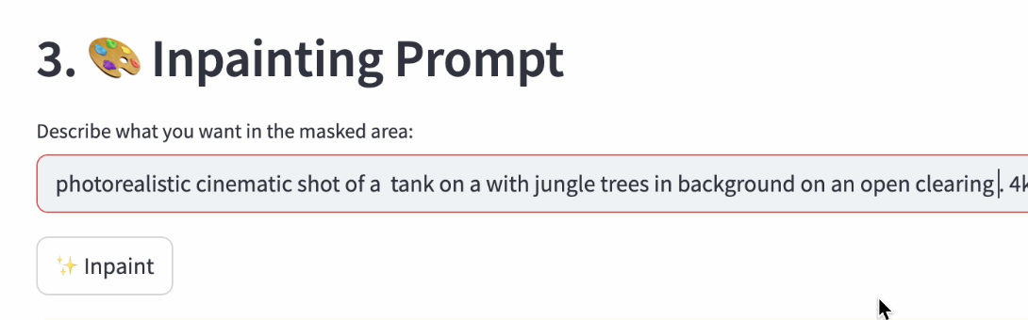
Image-to-Image Generation

Slide 11
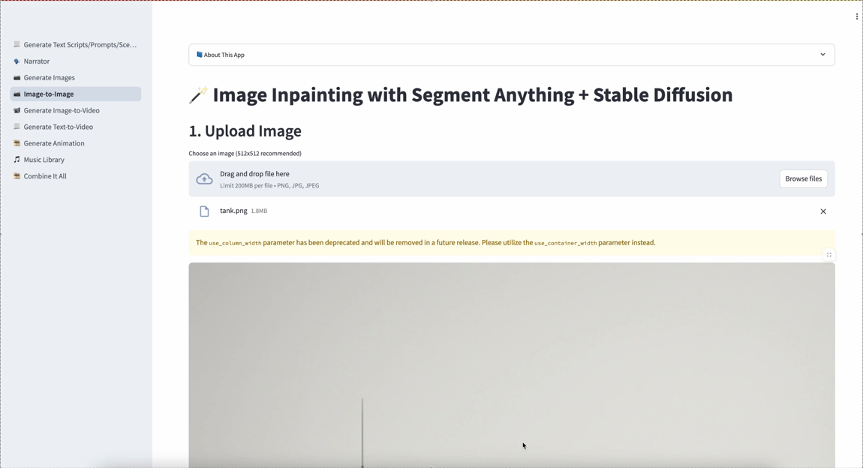

Slide 12
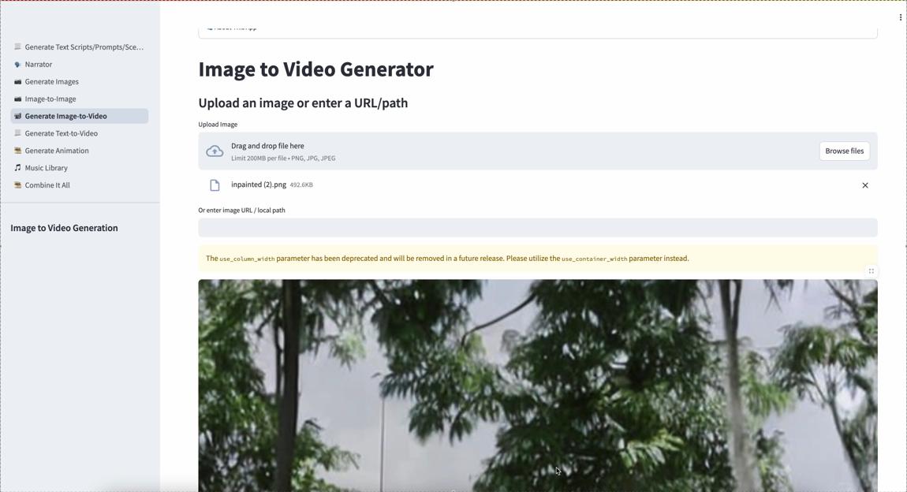

Slide 13
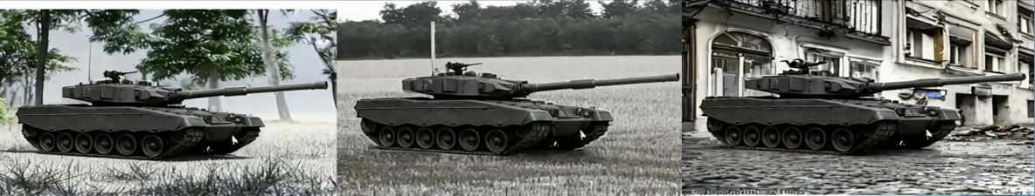

Slide 14
Scene Animation Builder
Tokenization
Breaks down complex text (e.g., battle scenarios) into structured tokens
Actions: Move, Fire, Hold
Units: ID, Type, Status, Strength
Enables AI to understand and process natural language inputs.
Structured Data Model
Organizes tokens into a semantic structure:
Unit, TerrainFeature, BattleEvent, etc.
Makes it easy to track states over time (positions, outcomes).
Bridge to Animation Tools
Data model acts as a blueprint for visualization:
Animate unit movements, terrain interactions, and battle phases.
Integrates with tools like Manim or game engines to generate dynamic visuals.
AI-Driven Integration
AI uses structured tokens to:
Generate realistic events
Predict outcomes or fill in narrative gaps

Slide 15
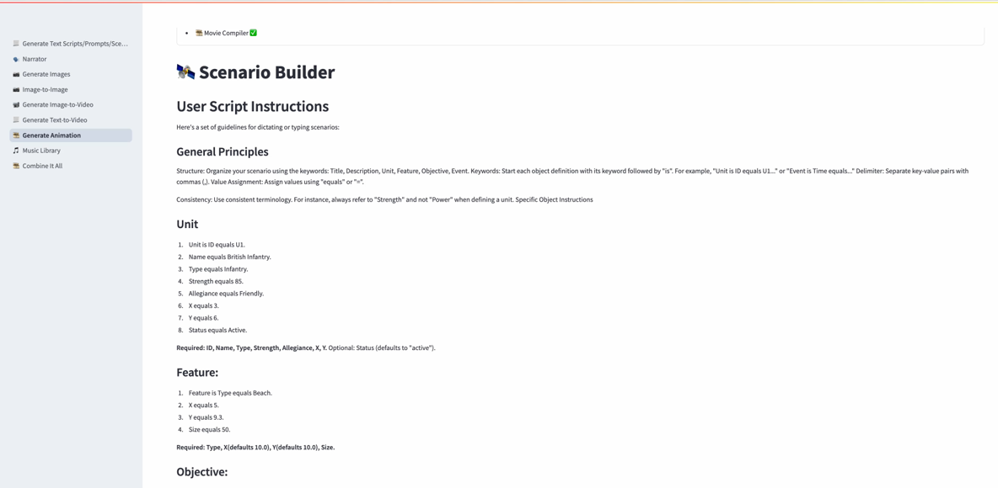

Slide 16
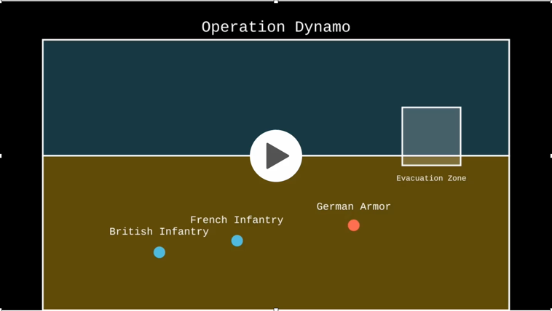
Scene Animation Builder

Slide 17
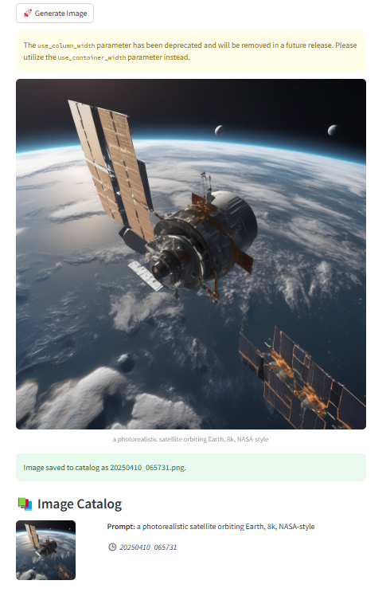
Image Catalog
Image Catalog
Central repository for unit icons, terrain symbols, effects, etc.
Enables consistent visual assets across scenarios.
Easy reusability and versioning for asset updates.
️ Effective Use
Tag assets by type, faction, scale, style, and usage.
Use naming conventions or folders for quick look-up by AI or scripts.
Link assets to scenario tokens for auto-rendering.
Automated Metadata via NLP
NLP parses text to auto-tag relevant image assets:
"A Sherman tank moves into a forest" → tags: Sherman, Tank, Forest
Saves time on manual labeling
Boosts accuracy and relevance of visual output.

Slide 18
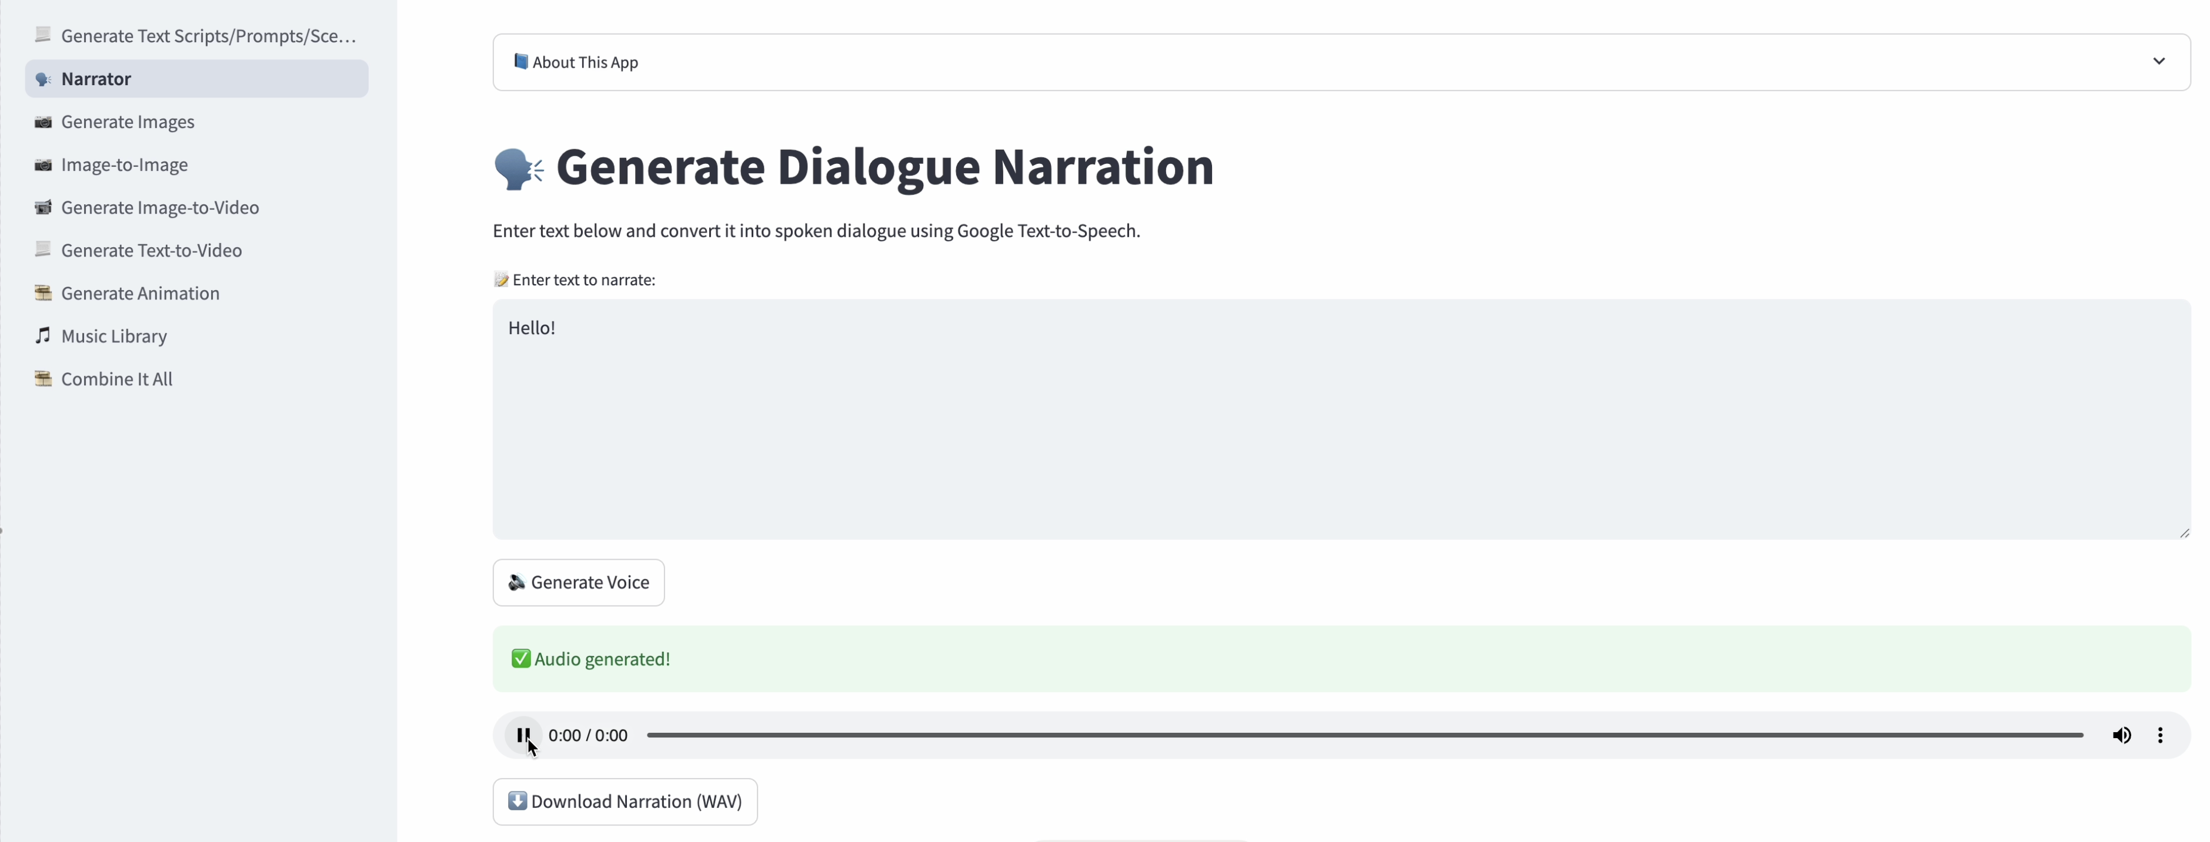
Text-to-Speech

Slide 19
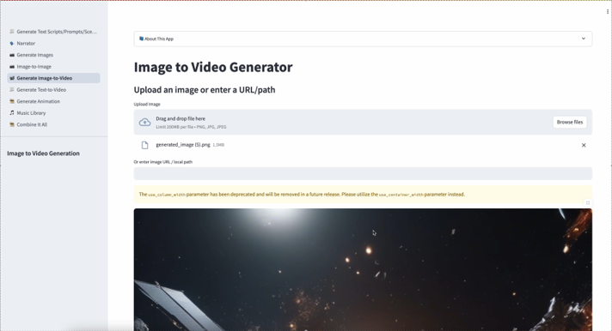
Image-to-Video

Slide 20
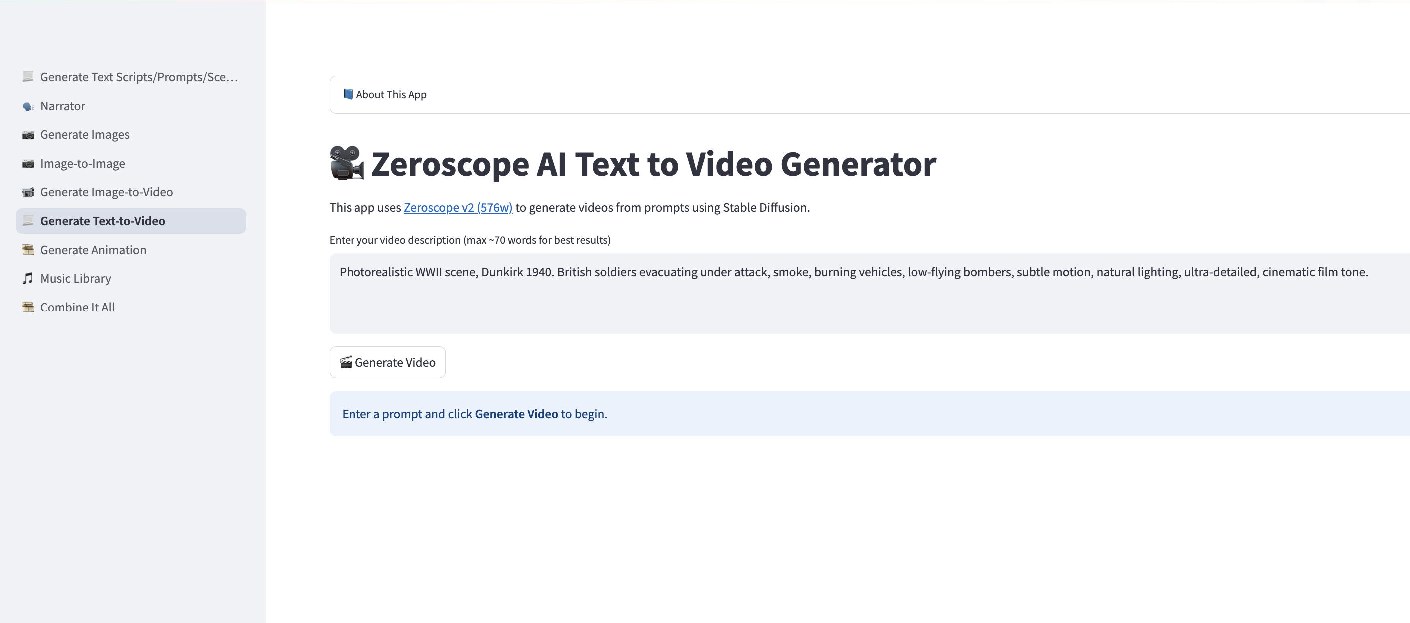
Text-to-Video

Slide 21
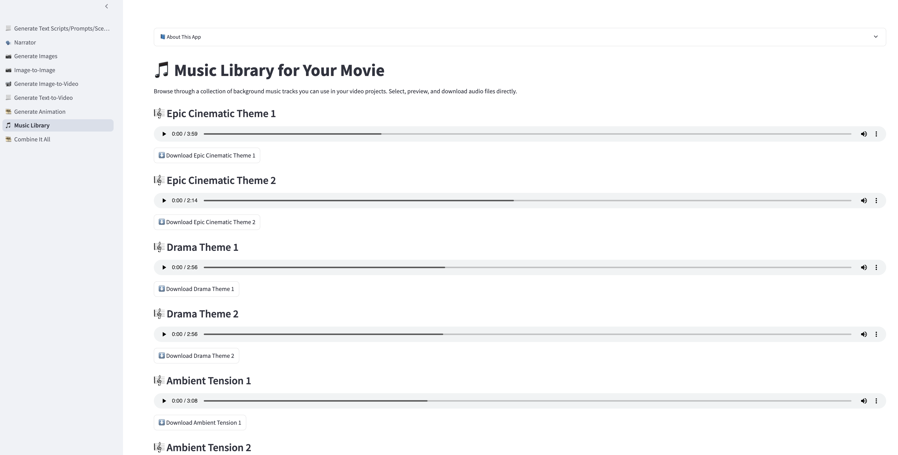

Music Library

Slide 22
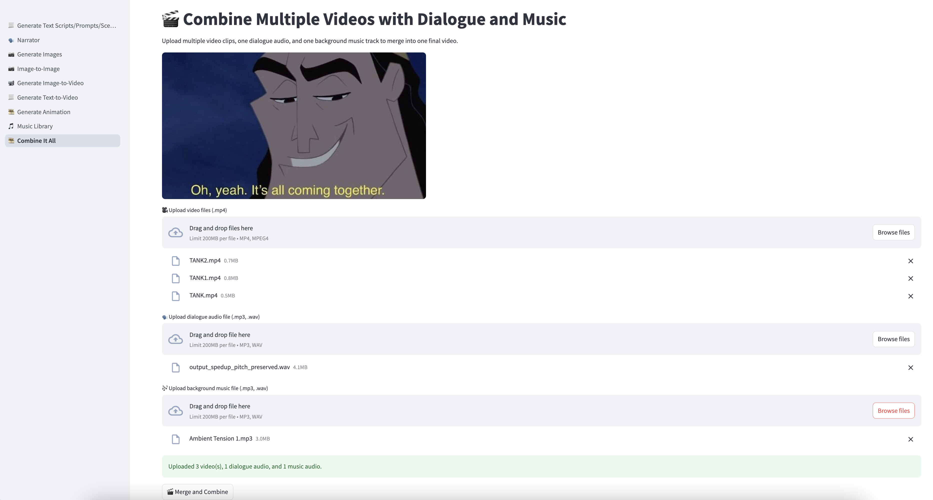
Combine it All

Slide 23
Lessons Learned/Challenges
May have to generate images multiple times to get the right image
Open Source AI image/video models are not the same quality level as commercial (Midjourney/Runway)
Battle Data Model
Without clear instruction, the model might generate vague, inconsistent, or overly verbose outputs that require heavy post-processing.
Trying to come up with a good scenario for a wargame
Combining video to match up with audio
Suggestion: generate shorter dialogue/video segments and the combine all with music in the end
GPU Resources (burning through resources through trial and error)

Slide 24
Wargame Scenario
"Operation Silver Wake" (Year: 2029)
(Opening – calm, strategic tone) "At 0430 hours, the United Coalition Task Force initiated Operation Silver Wake, a coordinated multi-domain strike to secure the disputed island of Varela Prime in the South Pacific — a critical node in the global quantum comms grid."
(Action – air and space) "At high altitude, a formation of stealth UAVs — Ghostwings — deployed from the airborne carrier CVX-1 Skyforge began their sweep. Precision strikes disabled enemy radar installations, guided by data streamed in real-time from Coalition satellites in geosynchronous orbit."
(Marine action – dramatic) "Simultaneously, the 5th Marine Rapid Insertion Unit launched from the amphibious assault ship Leviathan, cutting through the heavy surf in autonomous landing craft. Naval artillery from Coalition destroyers pounded hardened bunkers along the northern shoreline, clearing the beachhead."
(Enemy reaction – space and ground) "But the enemy was prepared. At 0445, a retaliatory burst from low-earth orbit disabled two Coalition satellites, disrupting comms briefly across the region. From camouflaged positions inland, railgun emplacements opened fire, targeting the second wave of insertion craft."
(Coalition counter – combined air-ground) "Reacting swiftly, air support from Falcon X jet-drones executed a deep strike, neutralizing the rail positions while cyberteams re-routed data flow through mesh UAV relays. On the ground, mechanized units pushed forward under cover of drone-operated smoke screens, linking up with forward scouts embedded days prior."
(Cliffhanger / transition) "The battle was far from over — and as night fell over Varela Prime, both sides braced for a second wave... in a war where the sky, sea, and space were equally contested."

Slide 25
AI Generated Wargame Video
See the video that is available on github.

Slide 26
Impact
The After Action Render suite transforms structured wargame data into dynamic, high-fidelity visual narratives using AI-driven tools for animation, dialog, music, and scene generation. This capability significantly enhances the effectiveness of wargaming in both training and operational contexts by enabling:
Seamless End-to-End Production From scenario data to final video output, everything happens within one pipeline—eliminating the need for multiple disconnected tools or manual stitching. This boosts speed, reduces errors, and ensures consistency.
Image Cataloging for Visual Accuracy & Reusability A centralized image catalog ensures standardized, faction-specific, and terrain-appropriate visuals, enabling rapid reuse across scenarios while maintaining realism and reducing manual asset searches.
AI-Powered Image & Scene Generation AI generates unit visuals, terrain layouts, and dynamic scenes on-the-fly, adapting to structured battle data. This delivers contextual visual fidelity with minimal design input—ideal for both SMEs and non-technical users.
Narrative Clarity Through AI Voice-Over Integrated dialog generation and voice narration provides contextual explanations of battlefield events, helping commanders, trainees, and analysts absorb complex scenarios quickly and intuitively.
Operational Advantage The unified tool creates clear, shareable visual narratives in a could significantly reduce time needed—enhancing pre-mission planning, after-action reviews, and cross-unit briefings in both classified and unclassified environments.
Notes:
Seamless End-to-End Production From scenario data to final video output, everything happens within one pipeline—eliminating the need for multiple disconnected tools or manual stitching. This boosts speed, reduces errors, and ensures consistency.
Image Cataloging for Visual Accuracy & Reusability A centralized image catalog ensures standardized, faction-specific, and terrain-appropriate visuals, enabling rapid reuse across scenarios while maintaining realism and reducing manual asset searches.
AI-Powered Image & Scene Generation AI generates unit visuals, terrain layouts, and dynamic scenes on-the-fly, adapting to structured battle data. This delivers contextual visual fidelity with minimal design input—ideal for both SMEs and non-technical users.
Narrative Clarity Through AI Voice-Over Integrated dialog generation and voice narration provides contextual explanations of battlefield events, helping commanders, trainees, and analysts absorb complex scenarios quickly and intuitively.
Operational Advantage The unified tool creates clear, shareable visual narratives in minutes—not hours or days—enhancing pre-mission planning, after-action reviews, and cross-unit briefings in both classified and unclassified environments.

Slide 27
Responsible AI & NATO Compliance
Lawfulness: Uses only human-authored scenario data (JSON input).
Accountability: Human-in-the-loop validation at all stages.
Explainability: Outputs traceable to structured tokens (units, events, terrain).
Reliability: Enforced via JSON schema + controlled vocabularies.
Bias Mitigation: No black-box AI—only structured, user-driven generation.

Slide 28
Next Steps
Remove the Hugging Face connection for the model
Dockerize and deploy instance in Azure Environment

